Slide 1

DETECTION OF FAKE SOCIAL MEDIA PROFILE AND VERIFICATION USING BLOCKCHAIN TECHNOLOGY
ANJALAI AMMAL MAHALINGAM ENGINEERING COLLEGE Kovilvenni , Thiruvarur , Tamilnadu.
Department of ECE
Guided By
Dr.S.Karthigaiveni
Assistant professor.
Department of ECE,AAMEC.
Akchaya K-820420106004
Poovizhi K- 820420106034
Pradeepa R-820420106035
Sneha Bai K-820420106043

Slide 2
PROJECT OBJECTIVE
This project introduces a blockchain-based profile authentication system to enhance security and privacy in online identity verification for social media.
Leveraging blockchain's decentralization and immutability, user profiles are securely stored and verified without intermediaries, reducing data breach risks.
Cryptographically secured profiles ensure confidentiality and tamper-proof records, fostering trust in the authentication process.
The decentralized nature of blockchain mitigates single points of failure, enhancing overall security and promoting privacy and trust in digital interactions.

Slide 3
EXISTING SYSTEM
Existing authentication systems rely heavily on centralized databases or password-based mechanisms, which are susceptible to inherent vulnerabilities compromising user security and privacy.
Centralized databases pose a single point of failure, heightening the risk of data breaches and identity theft.
Password-based authentication is vulnerable to weak passwords and reuse, increasing susceptibility to brute-force attacks.
SMS-based verification is insecure due to vulnerabilities like SIM swapping and interception, exposing users to unauthorized access.
Managing multiple accounts leads to insecure practices like writing down passwords, exacerbating security risks.

Slide 4
LITERATURE REVIEW
S.NO | TITLE | AUTHOR | YEAR | DESCRIPTION
1. | The Effect of Social Media User Behaviors on Security and Privacy Threats, (IEEE Access). | Aslihan Banu Cengiz | 2022 | Analyze social media user behaviors in terms of security and privacy
2. | Unreliable Users Detection in Social Media: Deep Learning Techniques for Automatic Detection. (IEEE Access). | Giuseppe Sansonetti, Fabio Gasparetti, Giuseppe D’aniello | 2020 | Present a predictive method for the identification of social network profiles accountable for spreading fake news.

Slide 5
LITERATURE REVIEW
S.NO | TITLE | AUTHOR | YEAR | DESCRIPTION
3. | BCOSN: Blockchain-Based Decentralized Online Social Network (IEEE Access). | Le Jiang, Xinglin Zhang | 2019 | Proposes a framework for decentralized online social networks using blockchain and smart contracts. It focuses on functionalities like authentication, newsfeed, and friend recommendations, demonstrating the potential for a decentralized social media infrastructure.
4. | Secure and Efficient Data Sharing Framework for Blockchain-Based Mobile Healthcare Applications. | Vidhya Ramani, An Braeken, TaneshKumar, Madhusanka Liyanage | 2018 | Presents a framework for secure and efficient data sharing in mobile healthcare applications using blockchain technology.

Slide 6
PROPOSED SYSTEM
Our Proposed solution , leveraging blockchain with SHA256 algorithm for profile authentication in social media app.
Decentralized authentication process on a distributed ledger eliminates single points of failure, enhancing security.
Integration of Aadhar card numbers provides a trusted identity proof stored securely on the blockchain.
Aadhar number integration adds an extra layer of trust and reliability, reducing fake accounts.
Overall, the solution strengthens security, enhances user safety, and creates a safer online environment.

Slide 7
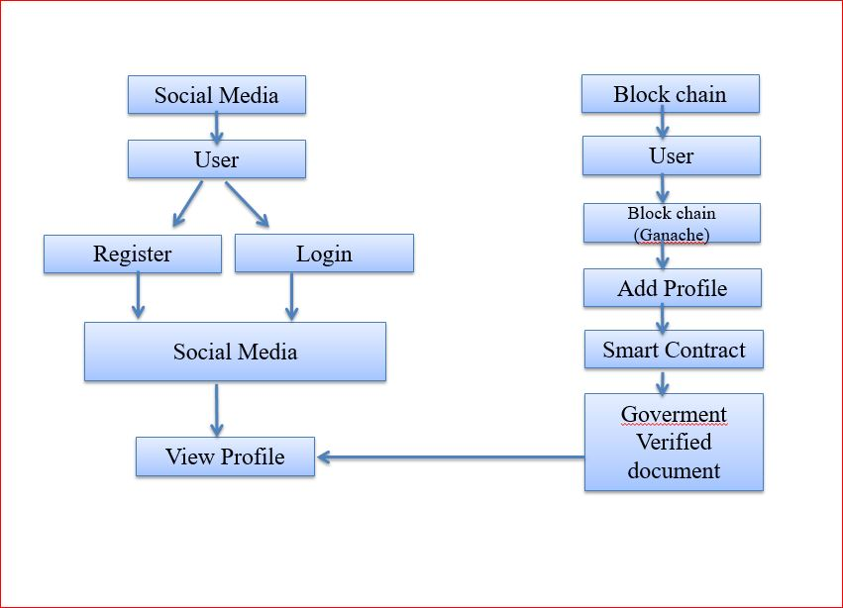
BLOCK DIAGRAM

Slide 8
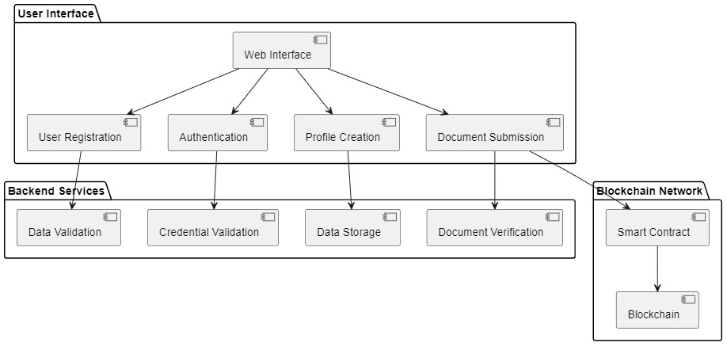
FLOW DIAGRAM

Slide 9
PROJECT MODULES
User Registration Module
Authentication Module
Profile Creation Module
Blockchain Integration Module
Verification Process Module

Slide 10
REQUIREMENTS
Software Description:
Front End :React.js,HTML/CSS/JavaScript,Axios.
Back End :Python Flask, Web3.py, SQLite
Blockchain Development : Ganache, Remix IDE.

Slide 11
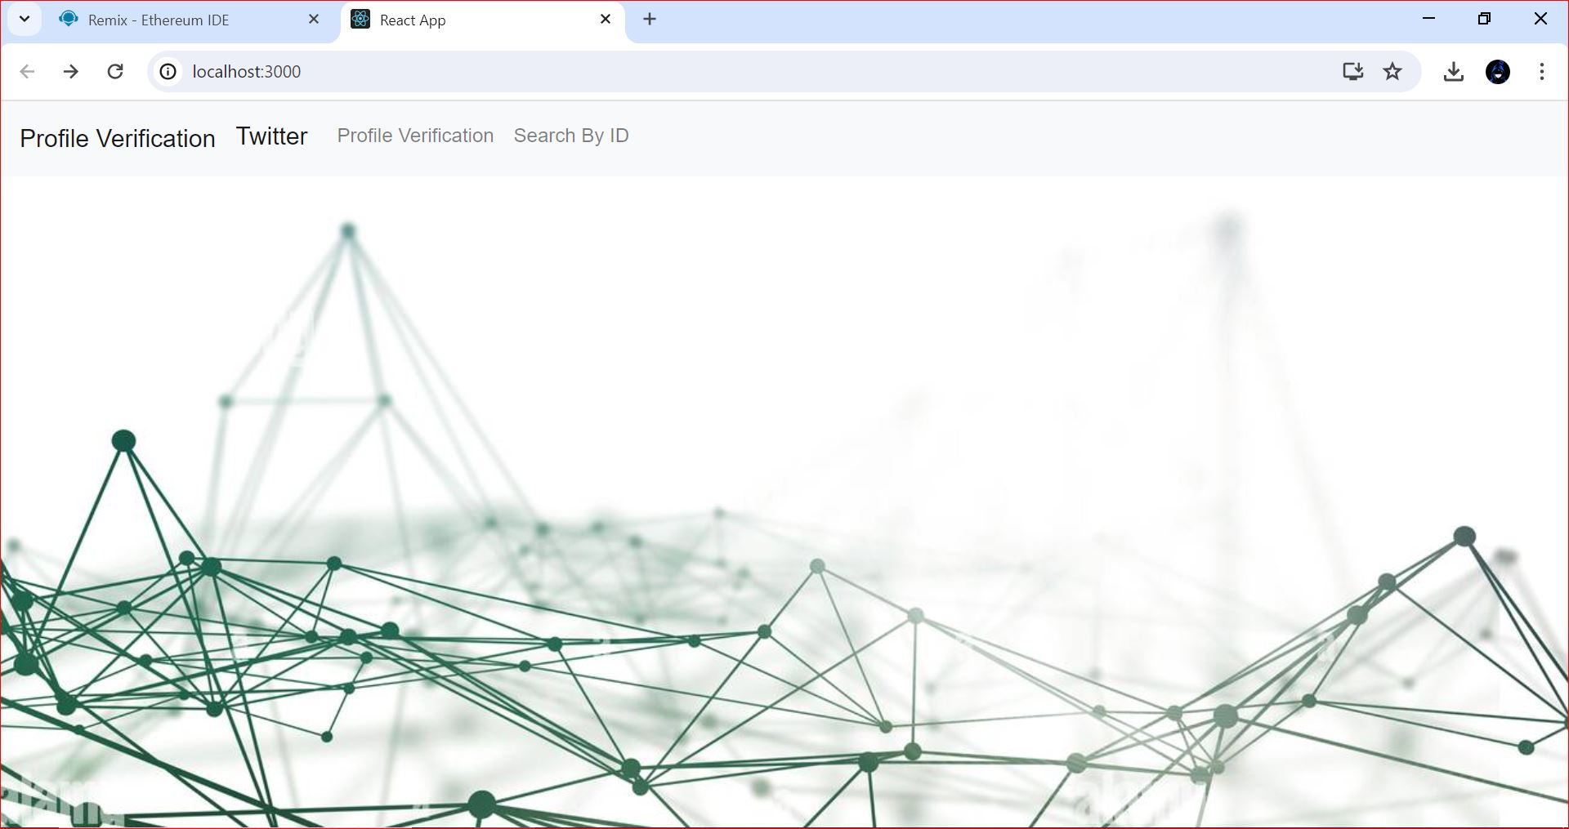
RESULTS
USER REGISTRATION MODULE
Application Frontend

Slide 12
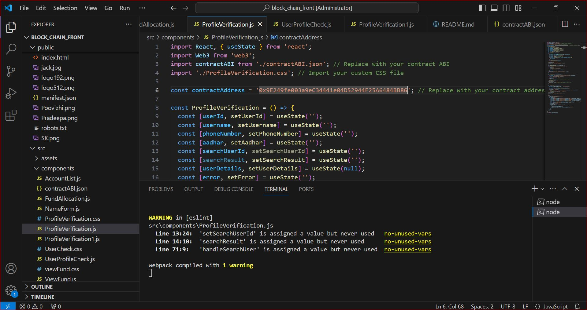
Source code

Slide 13
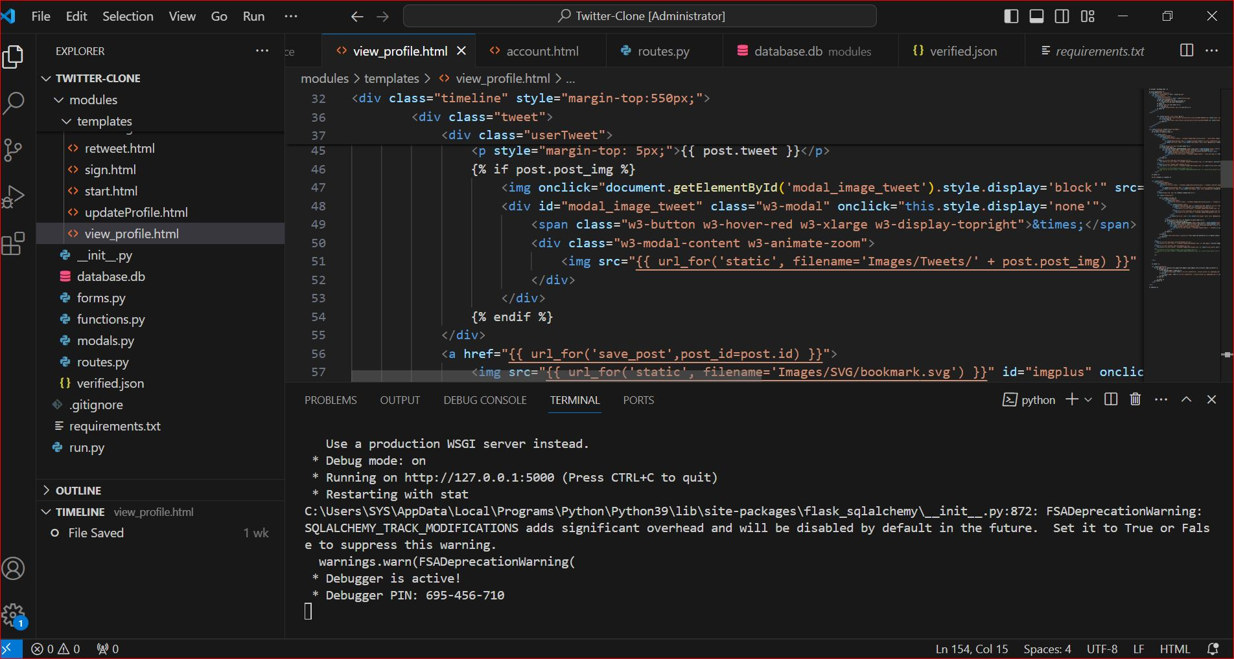
Twitter clone source code

Slide 14
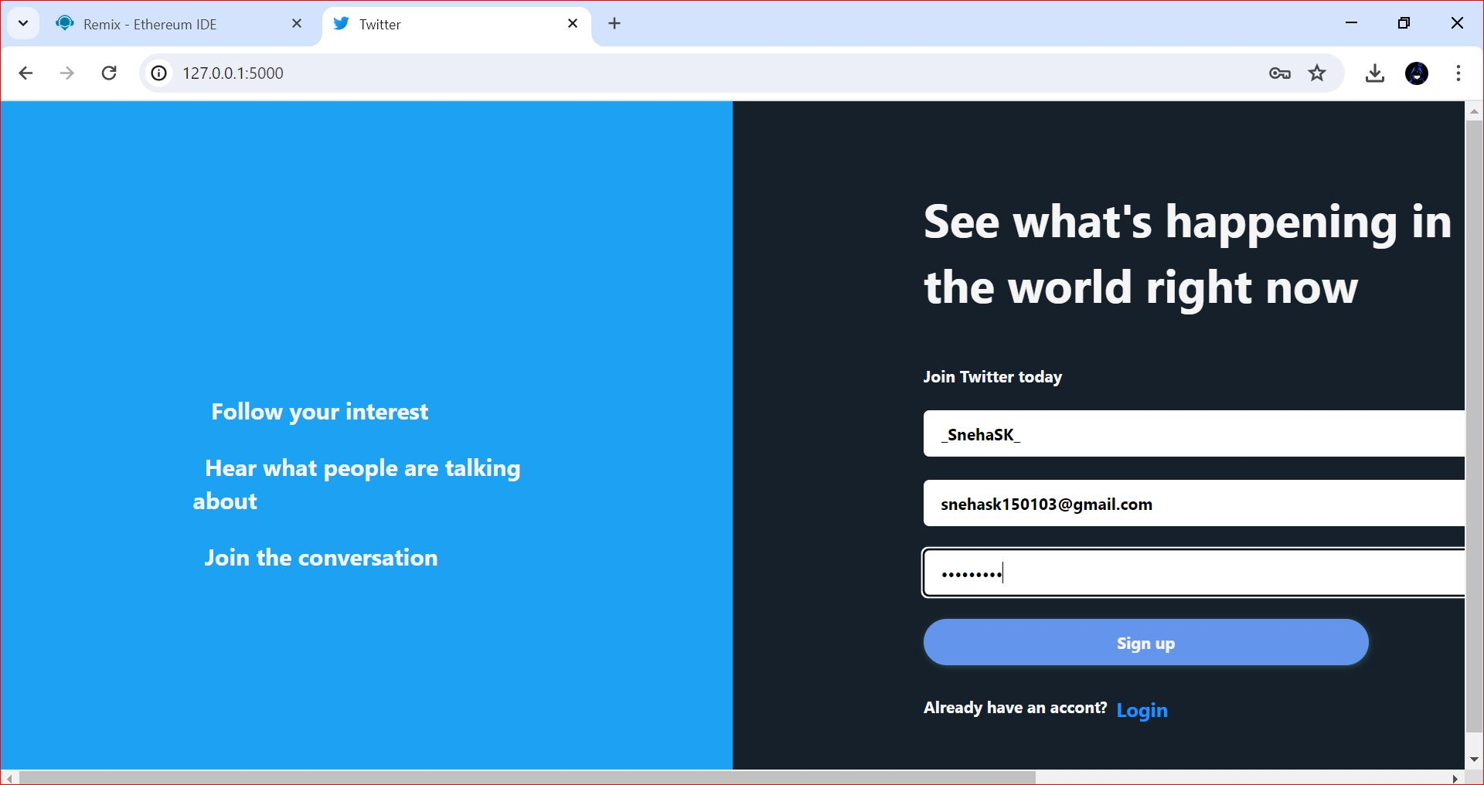
Twitter account Registration

Slide 15
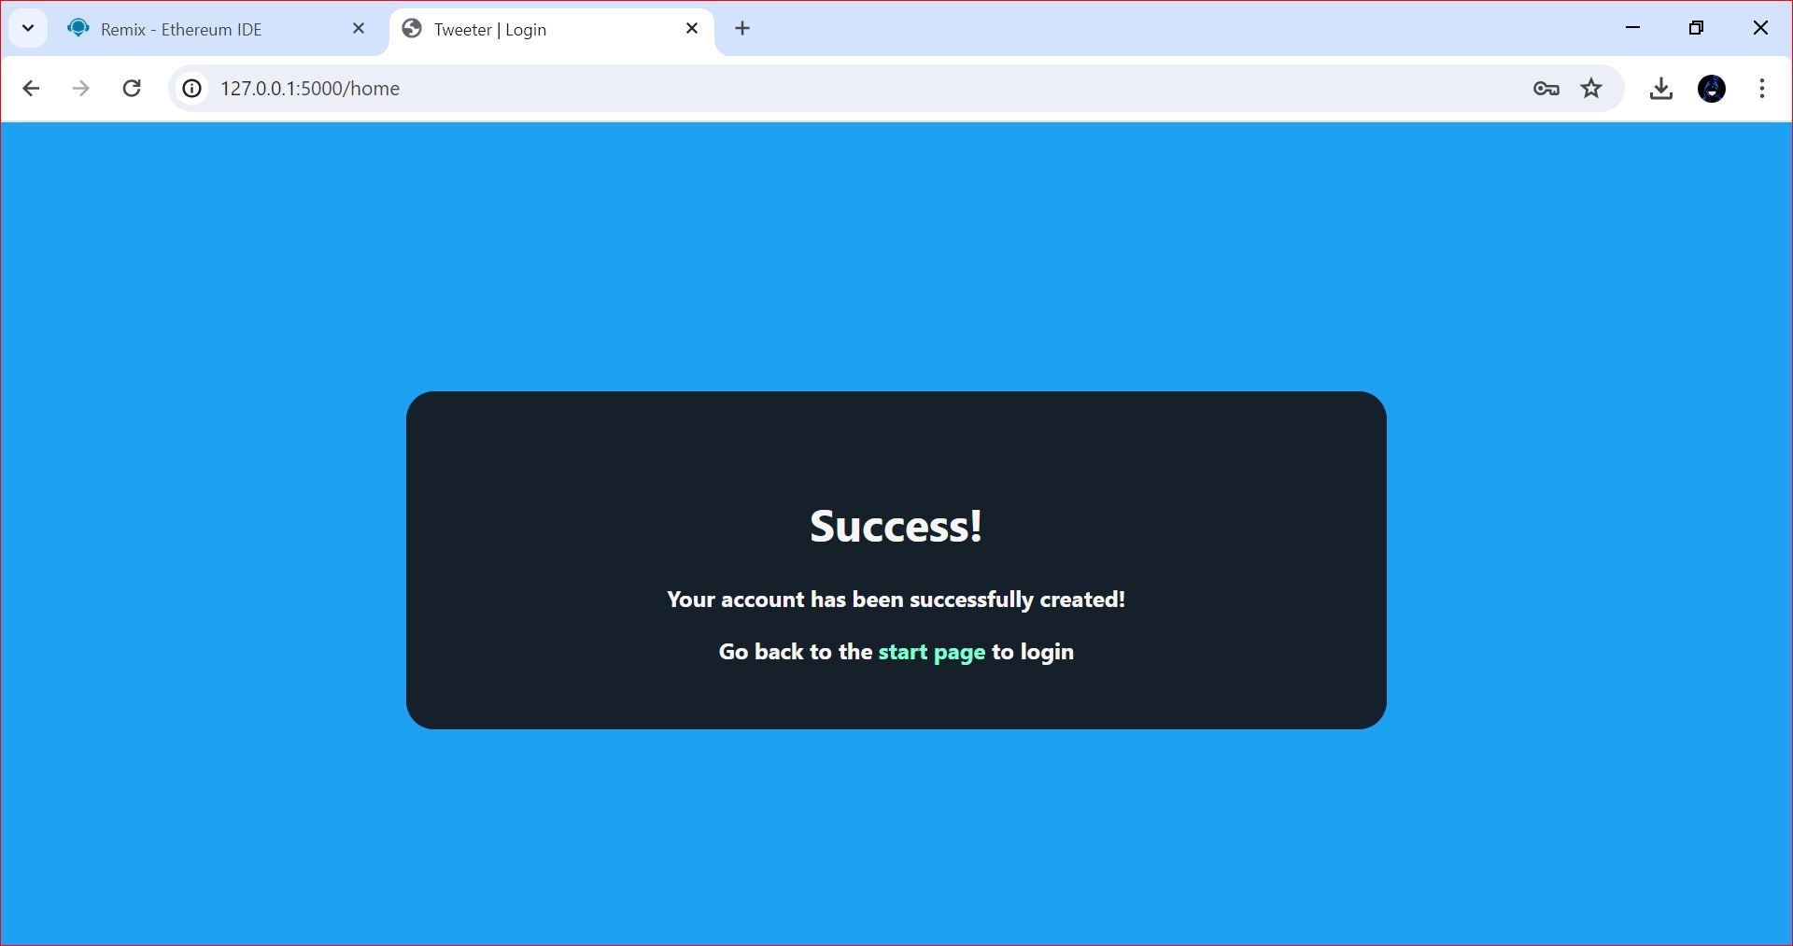
After Account Registration

Slide 16
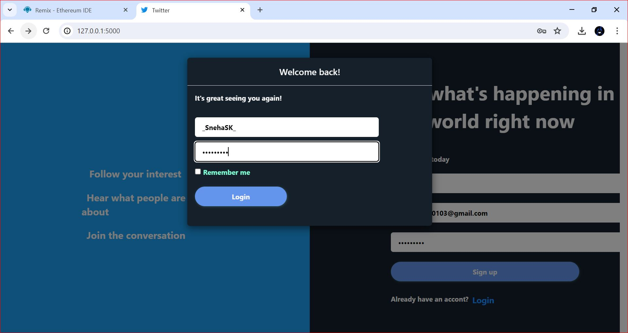
AUTHENTICATION MODULE
Twitter Account Login

Slide 17
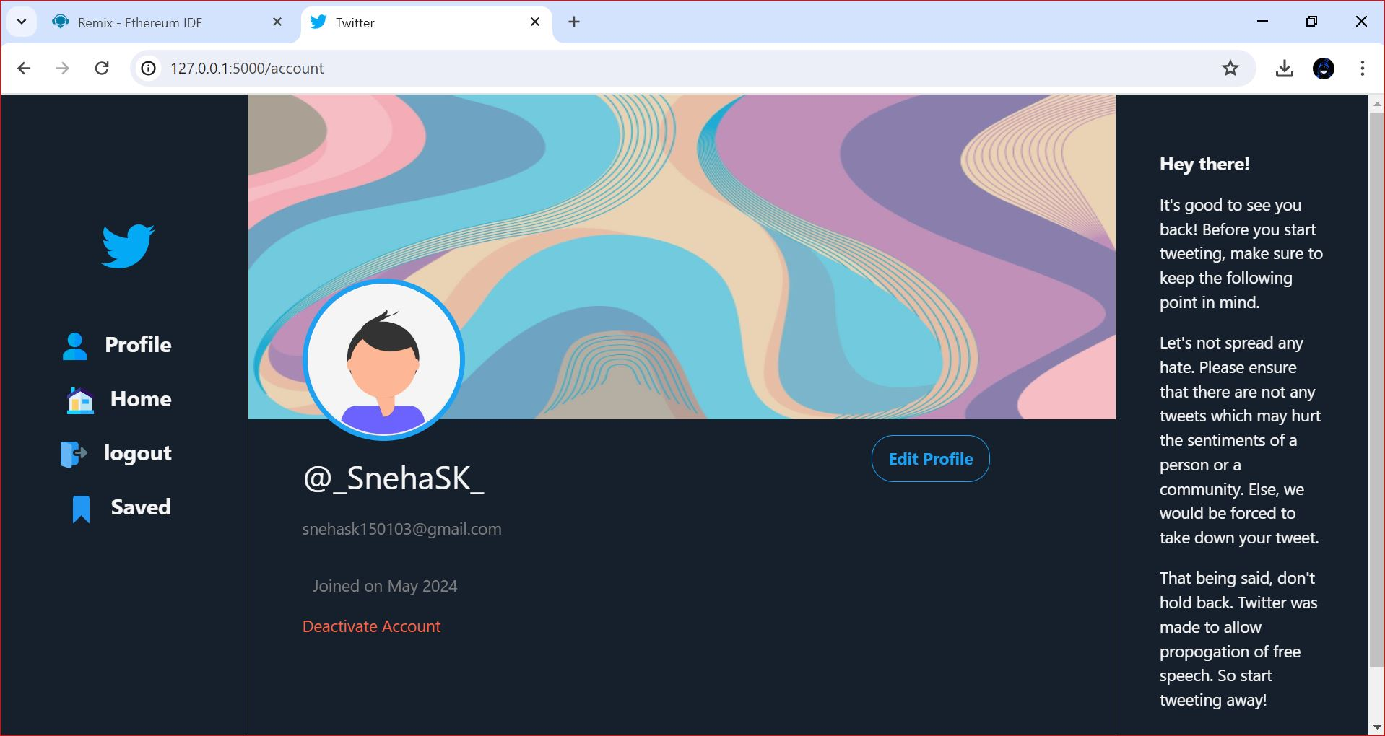
User Account Before Verification

Slide 18
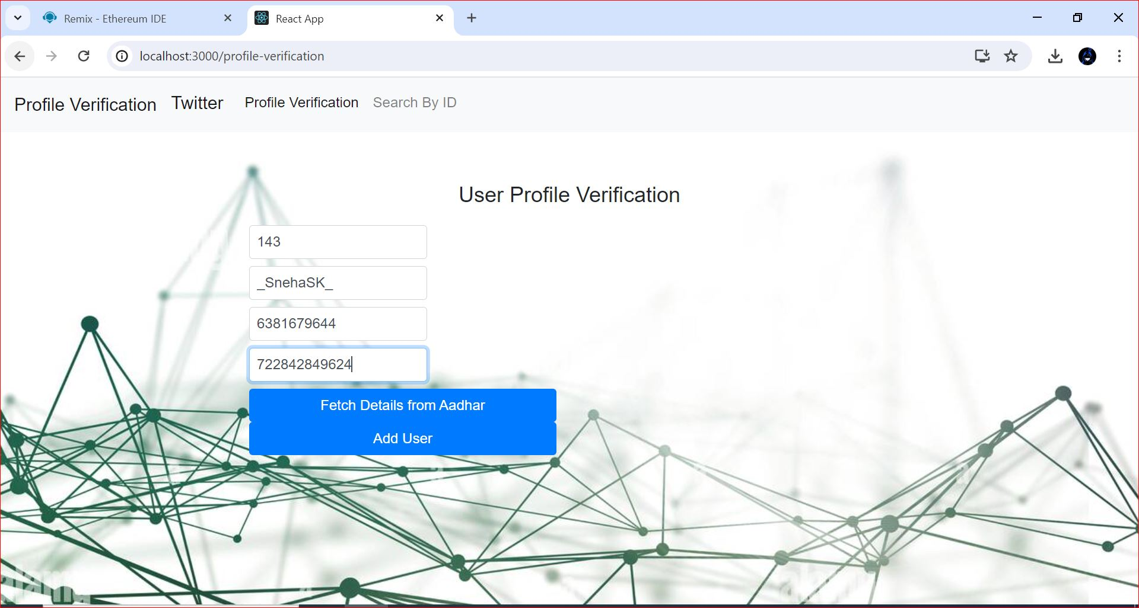
PROFILE CREATION MODULE

Slide 19
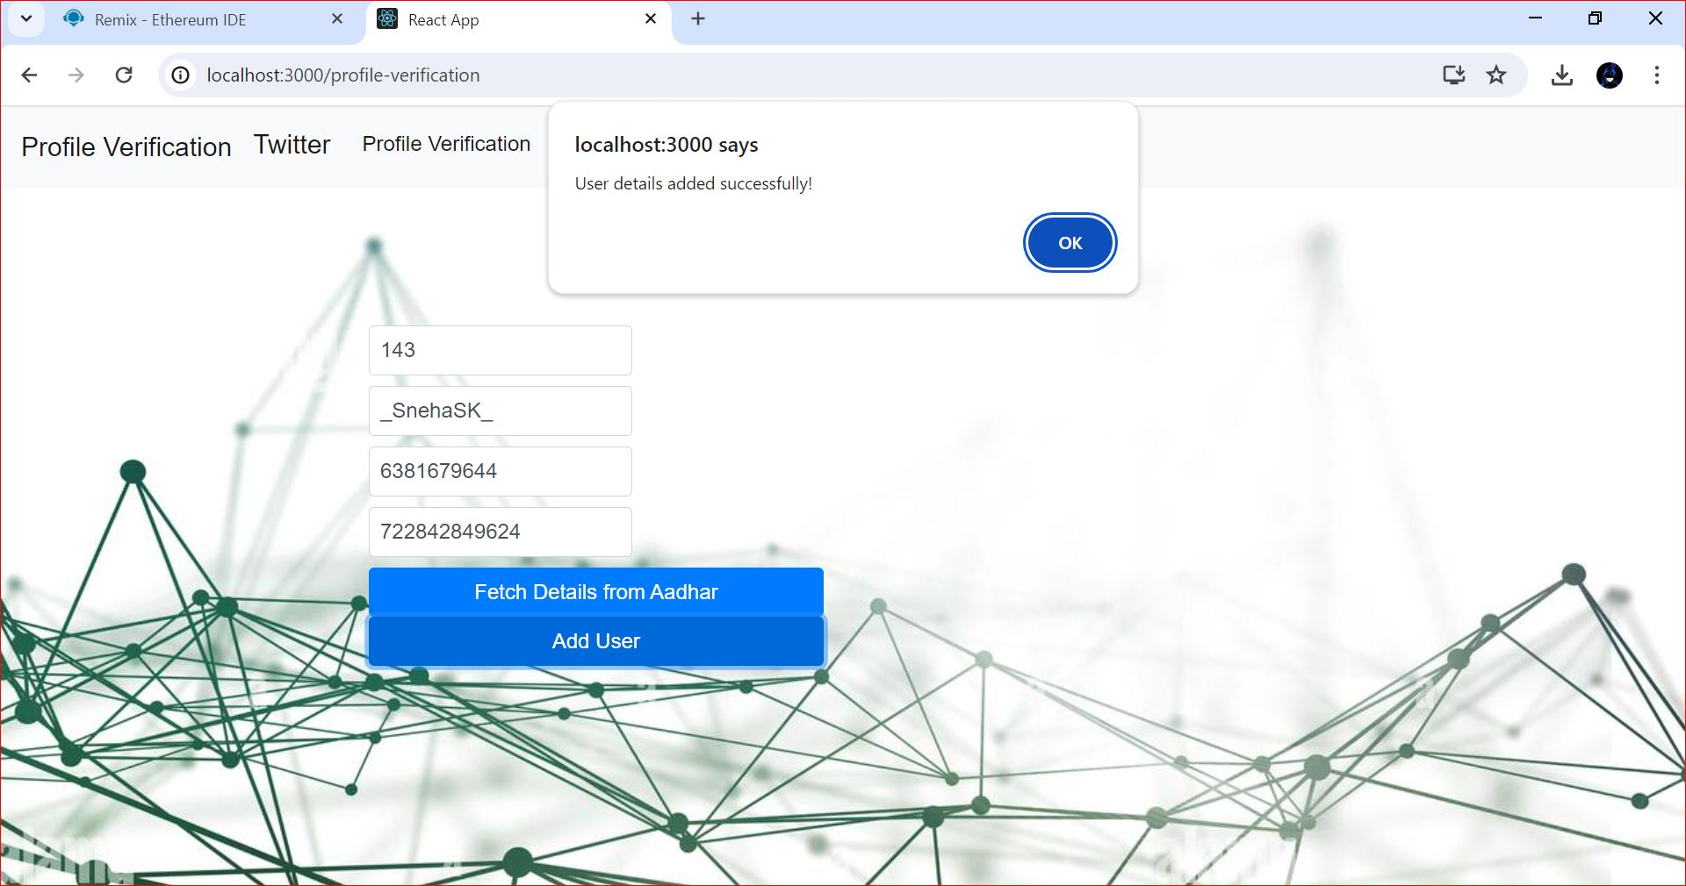
Profile Creation

Slide 20
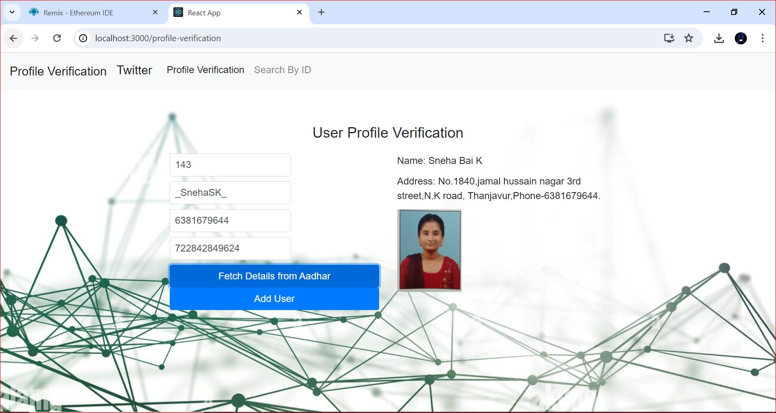
Aadhar information fetch from database through the user entering their aadhar number

Slide 21
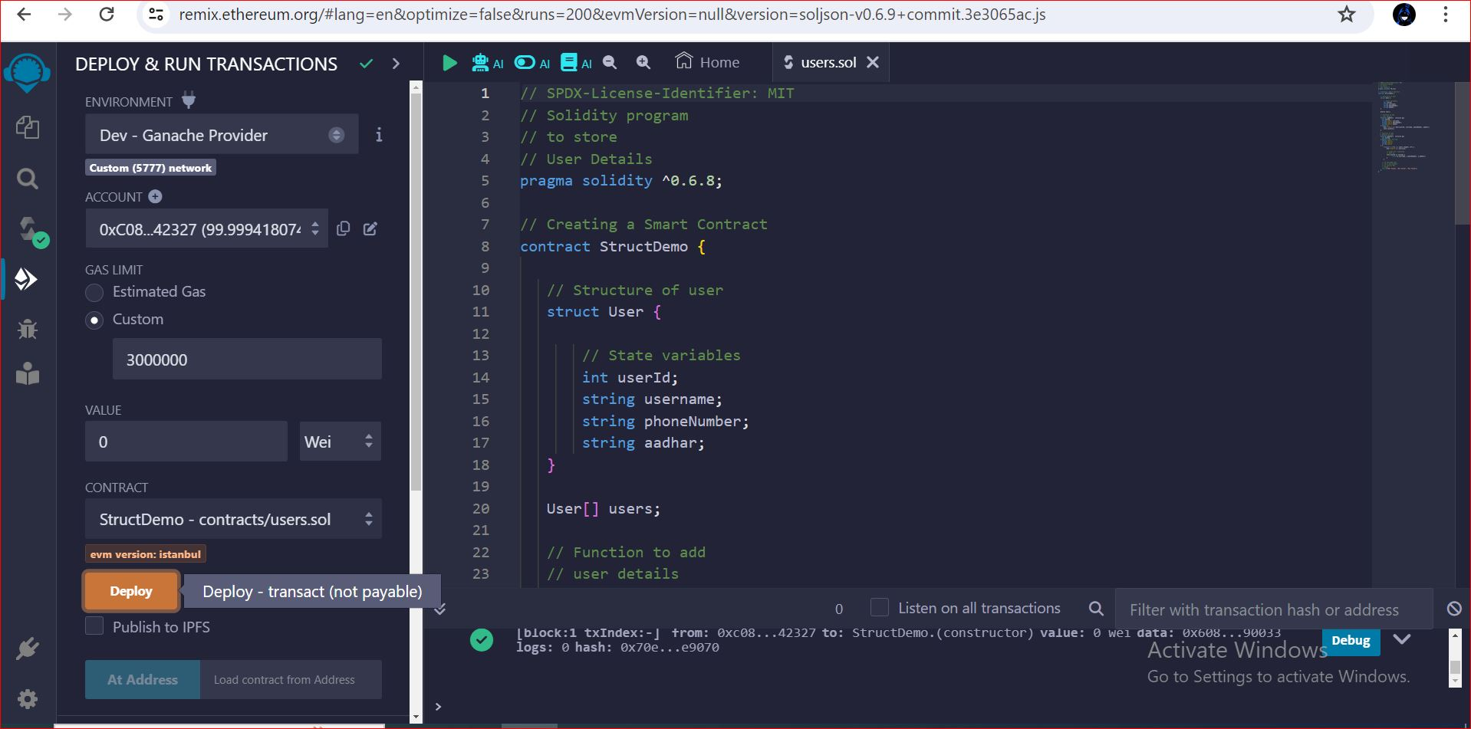
BLOCKCHAIN INTEGRATION MODULE
Profile verification smart contract code on Remix IDE

Slide 22
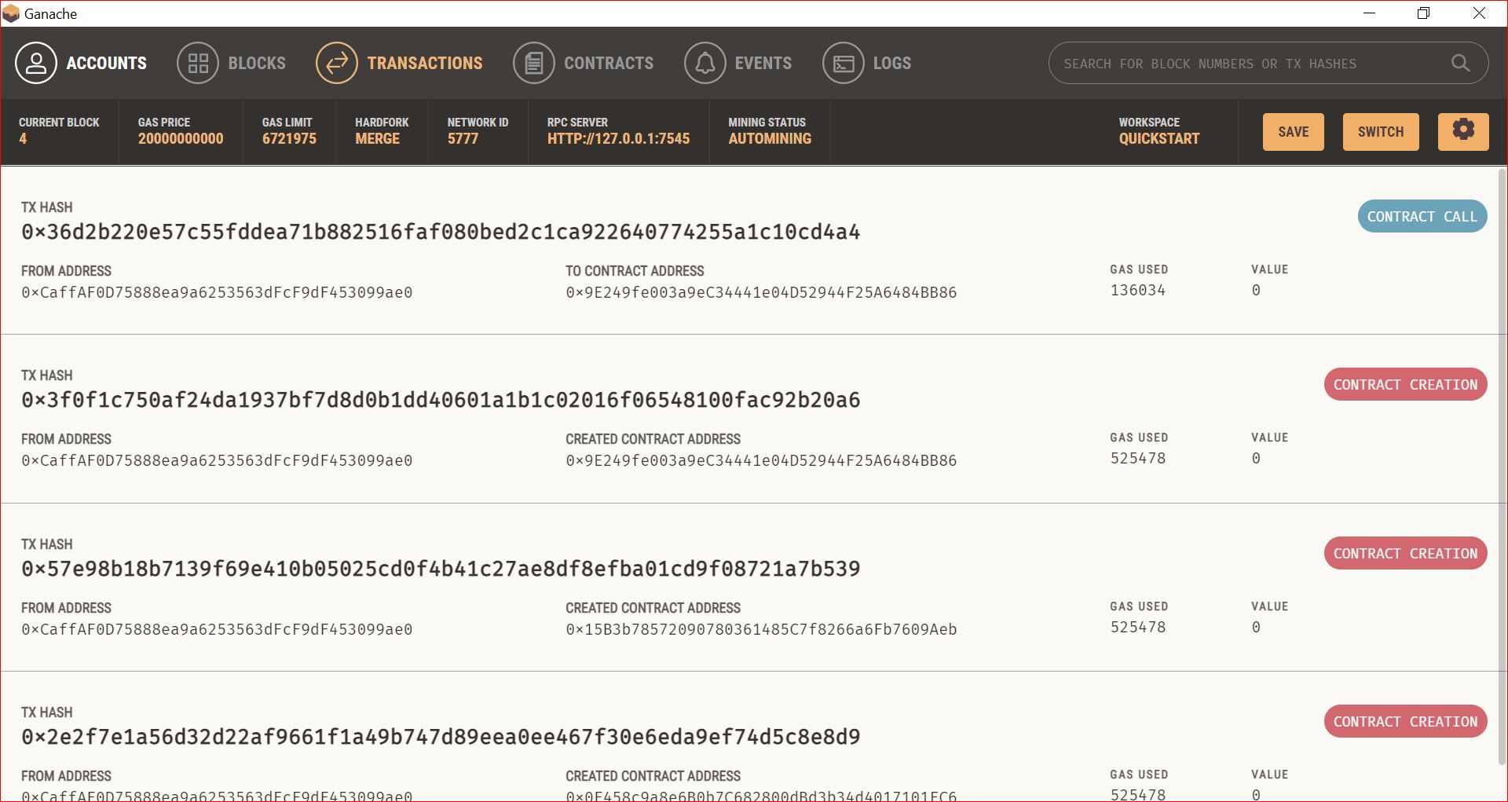
After the profile creation of a user it adds to the Ganache Blockchain Blocks

Slide 23
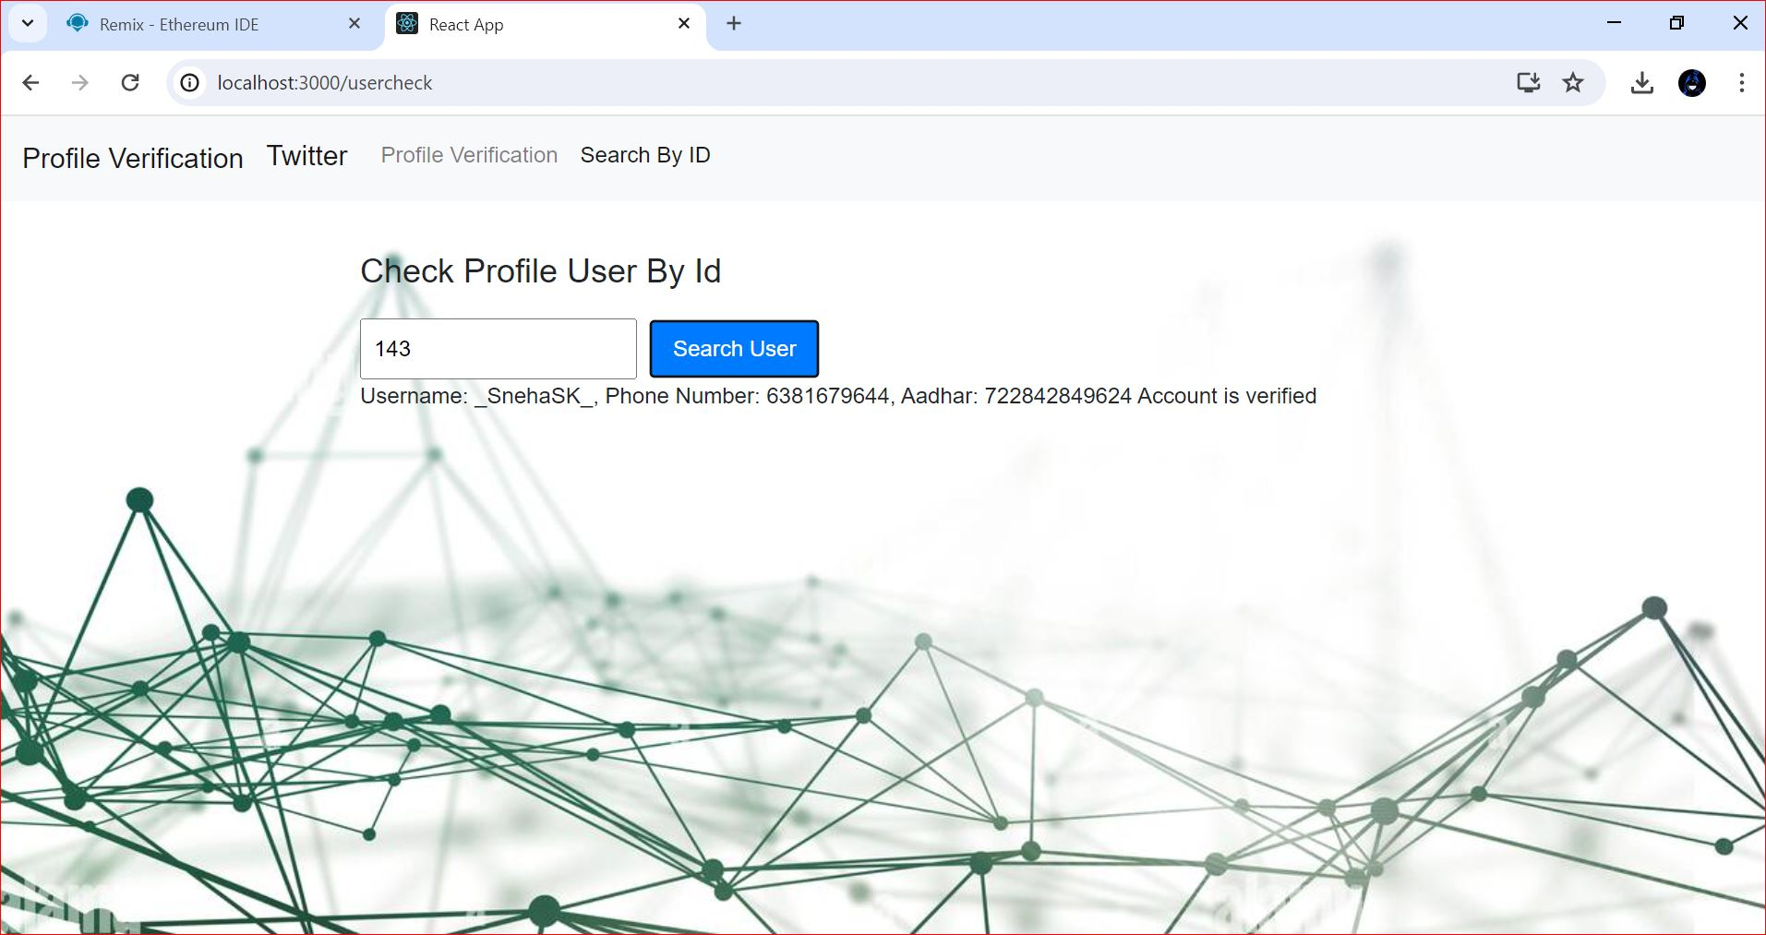
VERIFICATION PROCESS MODULE
Search User By Unique ID

Slide 24
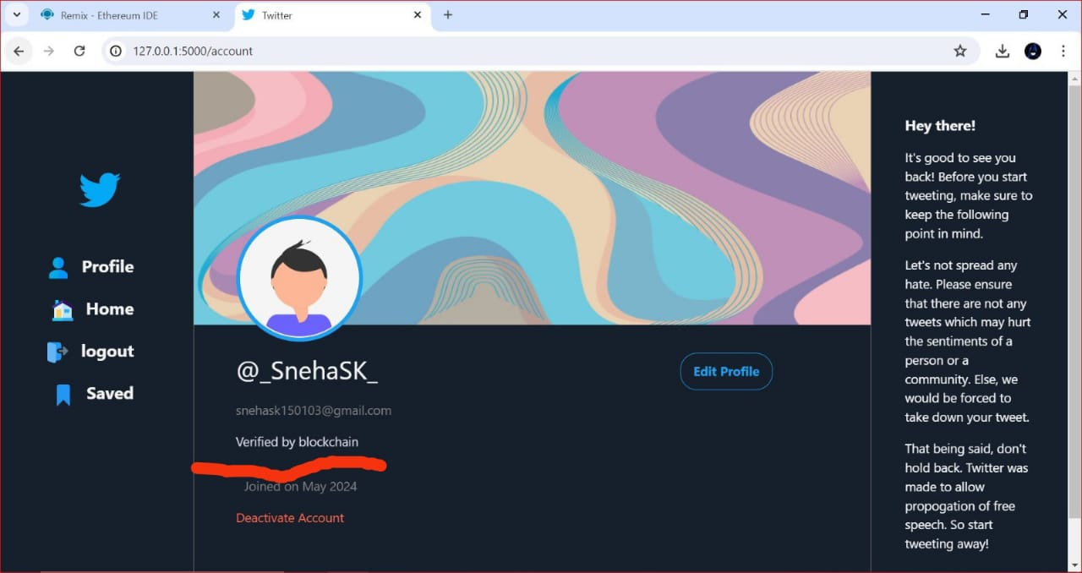
After Profile verification using blockchain Technology

Slide 25
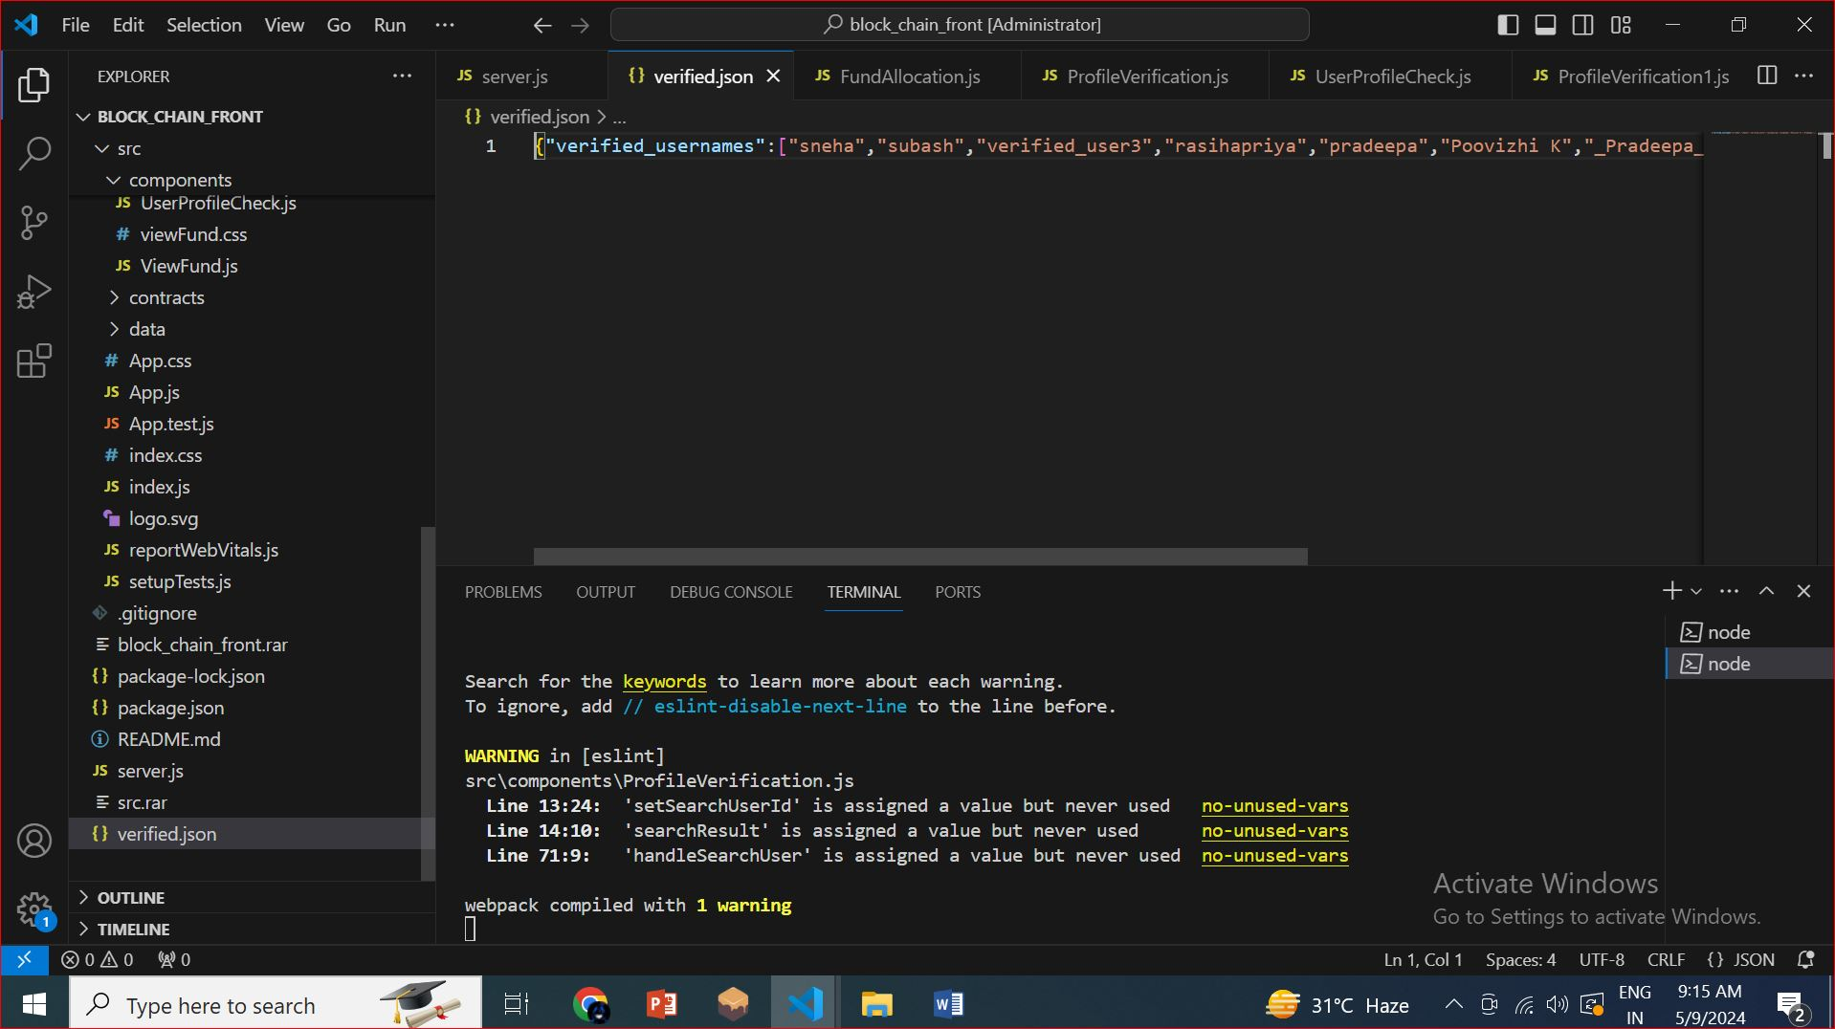
Verified users on json file

Slide 26
CONCLUSION
Integrating blockchain into profile verification systems enhances security, transparency, and trust by leveraging decentralization and immutability.
The streamlined process allows users to register, submit documents, and track verification status in real-time, fostering transparency.
Blockchain provides a tamper-proof ledger for storing verified profiles and documents, ensuring data integrity.
Smart contracts automate verification processes, improving efficiency and reducing manual intervention.
While offering benefits like enhanced security and efficiency, challenges such as scalability and regulatory compliance need addressing for widespread adoption.

Slide 27
THANK YOU

